Slide 1
Sklearn

Slide 2
Sklearn
A library that has alot of tools for predictive analytics
https://scikit-learn.org/stable/

Slide 3
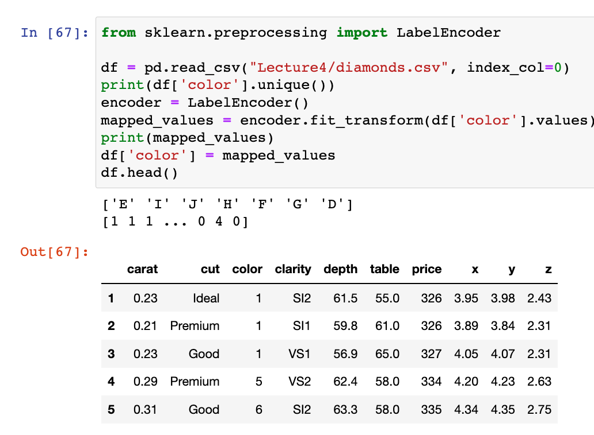
Mapping
We can use sklearn to programmatically assign labels. It uses a similar approach to using range of unique values

Slide 4

Mapping
One of the most common mistakes is, after mapping nominal features to numbers, we leave the new number representation with out removing the sorting and ordering that is inherent to numbers
In this example, if colors E=1 and D = 0 then a machine learning algorithm will assume 1>0, therefore E > D

Slide 5
Mapping: One hot encoding
Diamond Color
D
G
H
We use one-hot encoding as a workaround
How it works:
for each unique value in the nominal feature column (ie: colors), create a new dummy feature (ie: add new columns [E, I, J, H, F, G, D])
For each color value, we’ll assign 1 to the feature column for which is the correct color and 0 to the others
E | I | J | H | F | G | D
0 | 0 | 0 | 0 | 0 | 0 | 1
0 | 0 | 0 | 0 | 0 | 1 | 0
0 | 0 | 0 | 1 | 0 | 0 | 0

Slide 6
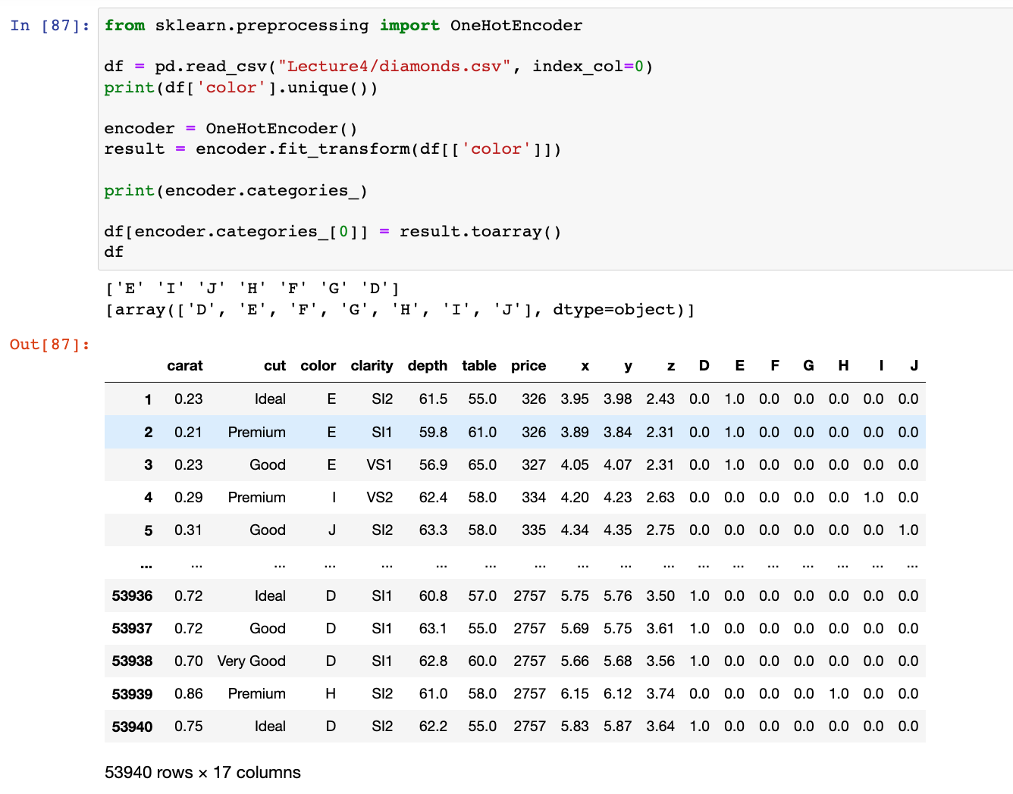
Mapping: One hot encoding
After transforming the nominal features, make sure to drop the original column! (color in this case)

Slide 7
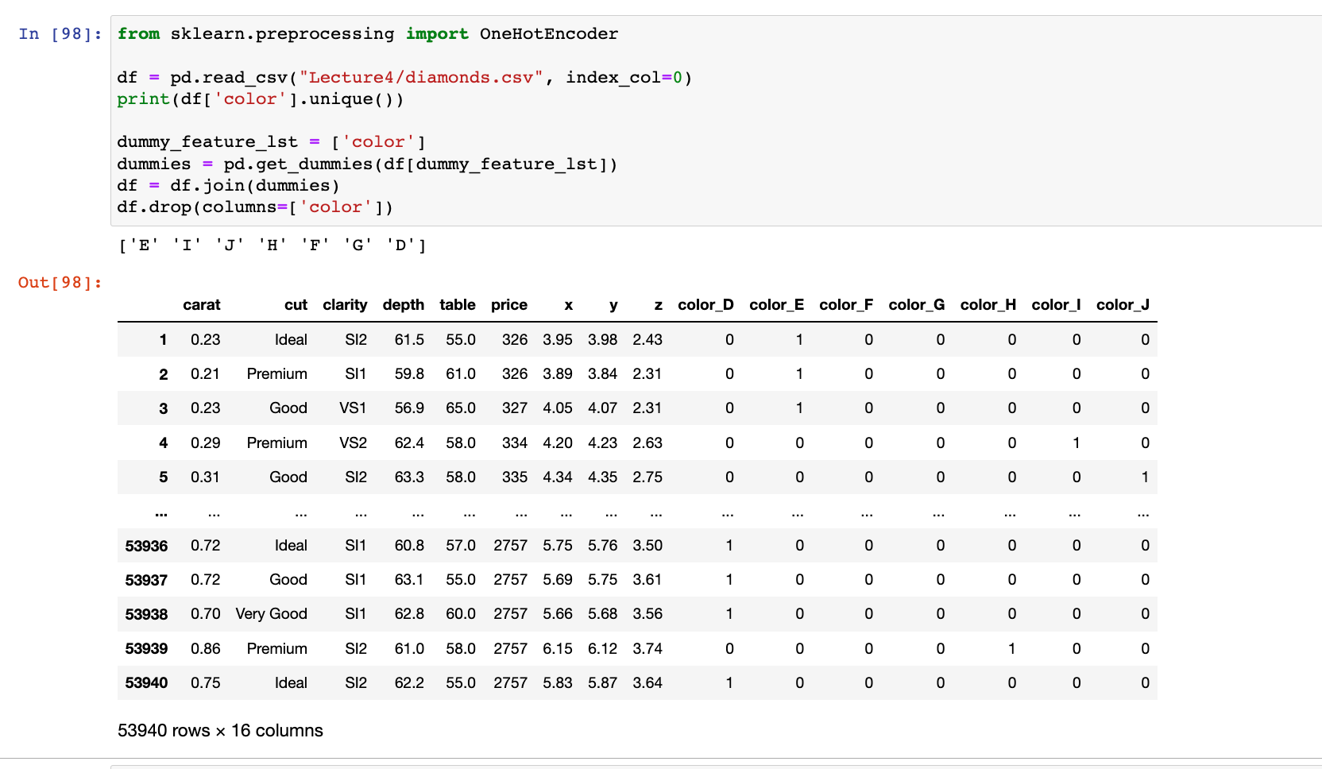
Mapping: One hot encoding
This can also be accomplished with the pandas function “get_dummies” but it only works for string values

Slide 8
KNN Imputation with Sklearn
We’ve already seen these in class examples, but Sklearn is the library we use to impute data
Let’s put together everything that we’ve learned to get our ‘ratings’ column in the ‘netflix_titles’ dataset ready to be used for either machine learning training or evaluation

Slide 9
KNN Imputation with Sklearn
First we’ll need to fill in missing rating values
KNN looks at ‘k’ nearby values (or neighbors) to try to impute missing values.
We’ll order or group our rows by director
We’re going to assume that movies by the same director have similar ratings
Quentin Tarantino movies are usual R or NC-17
Steven Spielberg movies are usually PG or PG-13

Slide 10
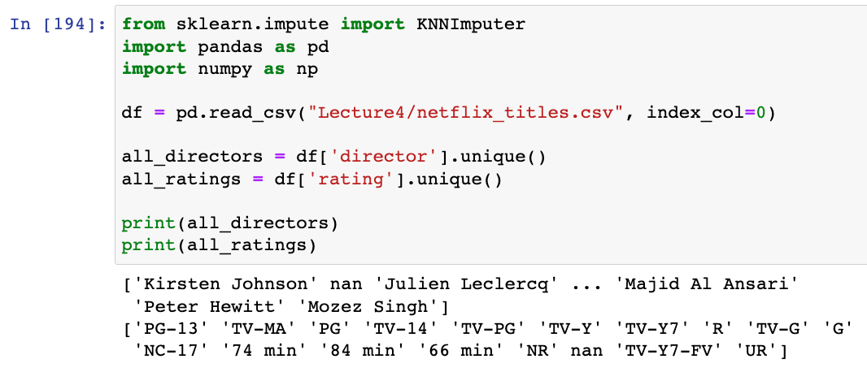
KNN Imputation with Sklearn: mapping
Get all the unique values for the director and rating features.

Slide 11
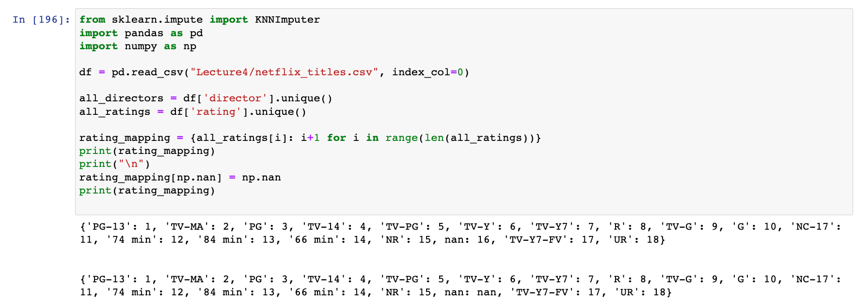
KNN Imputation with Sklearn: mapping
Let’s map the rating values to integers so we can use KNN (or any imputer) to predict the missing data
It’s important to replace the mapping for “nan” (missing number) with np.nan because our imputer is going to look for np.nan values to replace

Slide 12
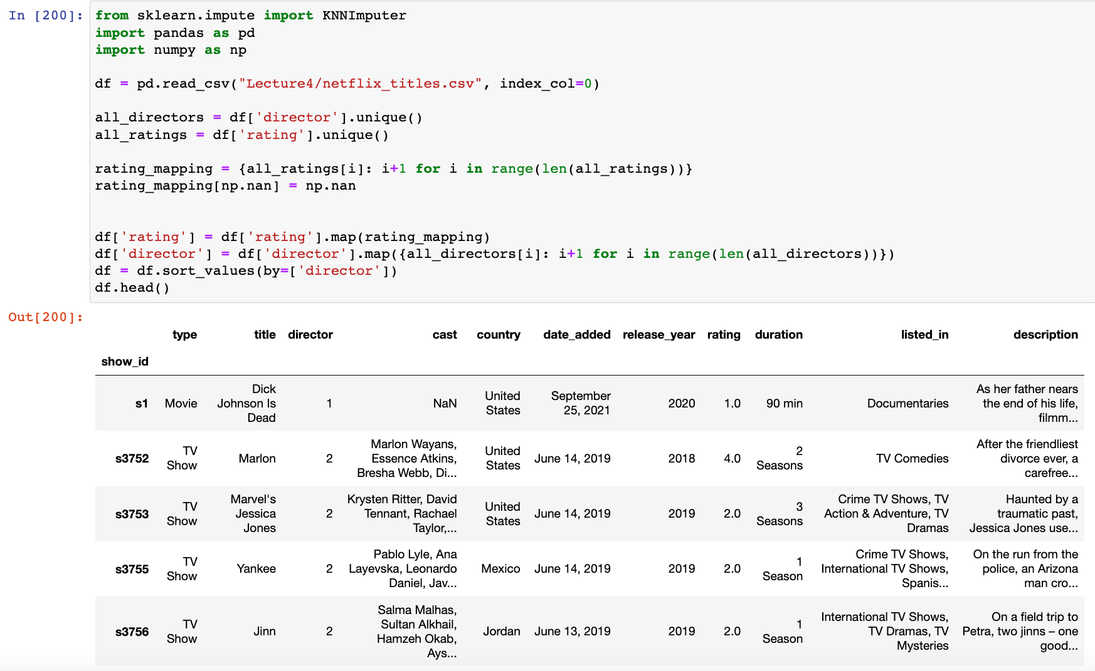
KNN Imputation with Sklearn: mapping
Next, assign the mappings to their respective columns

Slide 13
KNN Imputation with Sklearn: mapping
Next, group (or sort) the table by director.
We could do multi-level sorting for better predictions, but we’ll stick to something simple for now

Slide 14
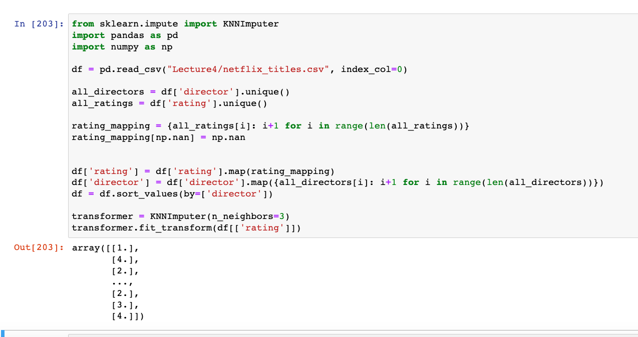
KNN Imputation with Sklearn: KNN
Perform the imputation for the ‘ratings’ column
Notice that what’s returned is a list of a list of numbers, we’ll need to transform this into a list so we can update the column values in our data frame

Slide 15
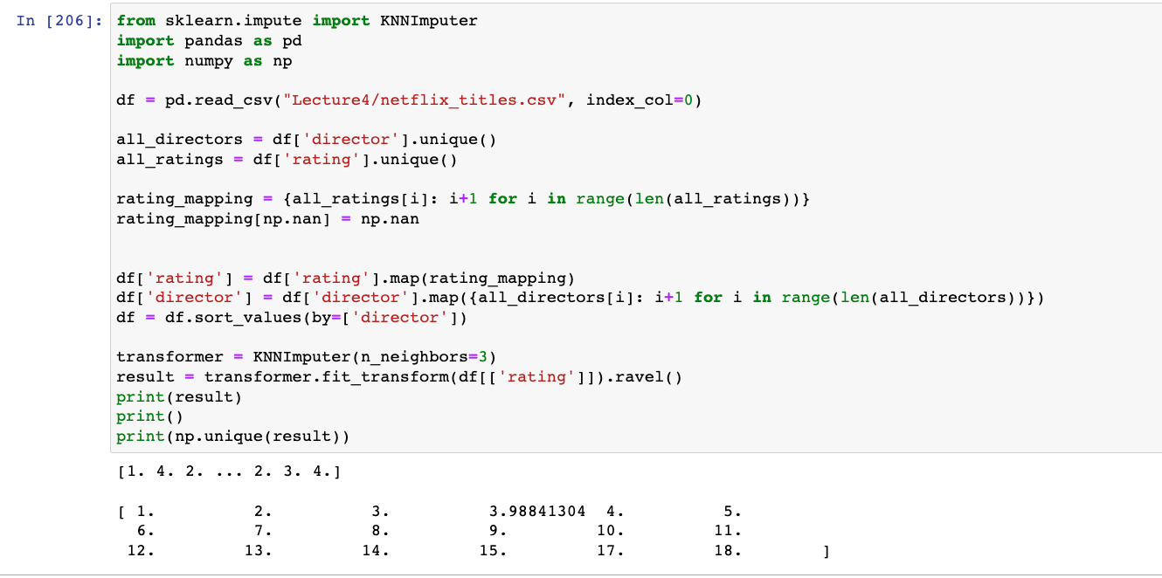
KNN Imputation with Sklearn: KNN
Using ‘ravel()’ we can flatten the 2d array (list of lists, like an image) into a 1d array (list).
However, our numeric rating values now contain a new, unmapped number.
This is the value that was imputed.
We can use this value as, but leaving the ratings as a number will now make the ratings category ordinal and may be misinterpreted by a machine learning algorithm

Slide 16
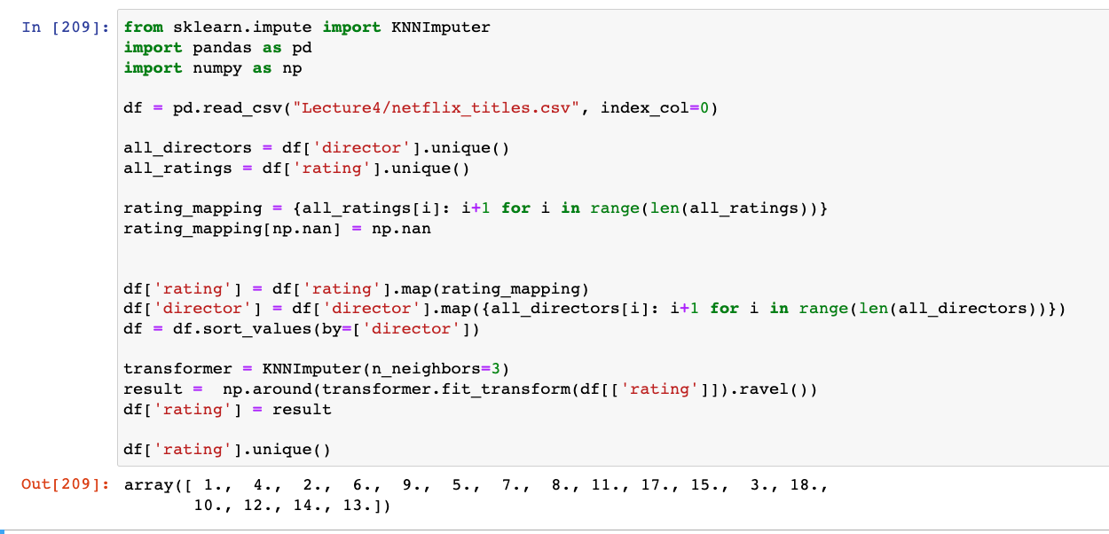
KNN Imputation with Sklearn: KNN
So we’ll round the imputed value to the nearest whole number (as used in our mapping). This will enable us to convert the numbers back into ratings and perform one-hot encoding

Slide 17
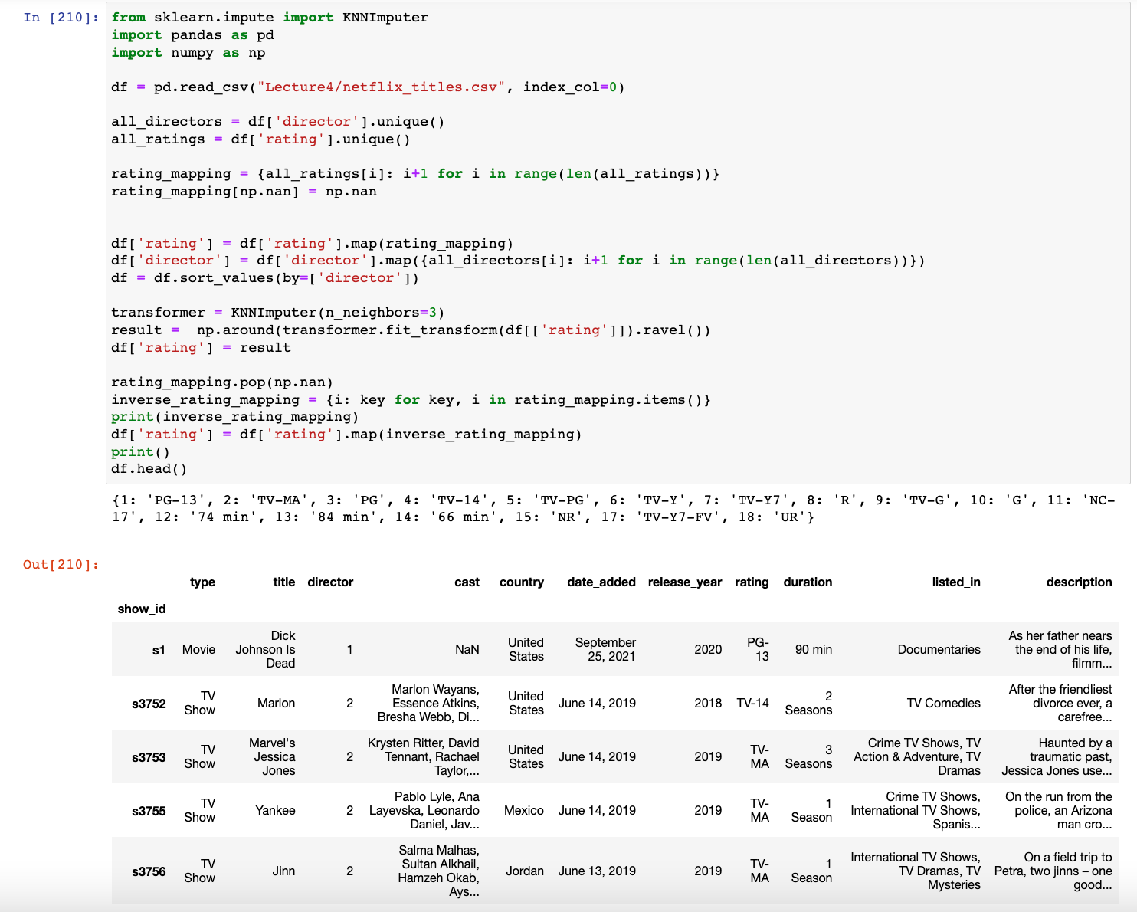
KNN Imputation with Sklearn: one-hot encoding
We need to create an inverse mapping to map the numerical ratings back to string or categorical ratings
Then we assign the inverse values back to the ratings column

Slide 18
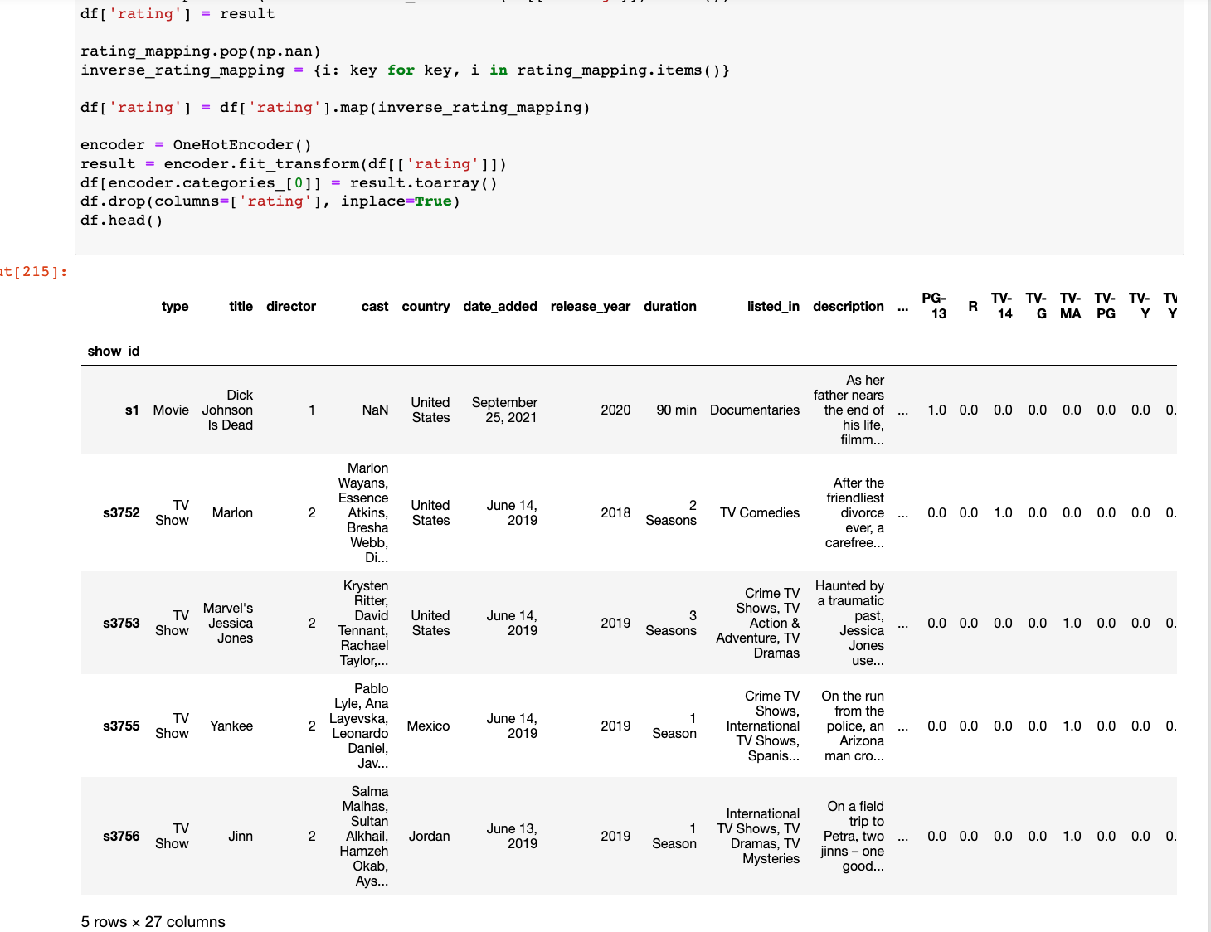
KNN Imputation with Sklearn: one-hot encoding
We can now use one-hot encoding to handle the nominal ‘rating’ data
We also drop the “rating” column since it is no longer needed

Slide 19
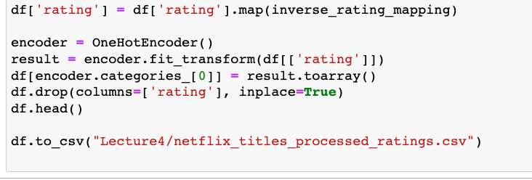
KNN Imputation with Sklearn: saving
Finally, let’s save our nicely-processed ratings data so we don’t have to process it again!

Slide 20
Linear Regression with Sklearn
Let’s perform a prediction with regression instead of KNN.
We need to use a non-categorical variable.
Using a data set of university student’s monthly spending, predict the missing study years using linear regression. Use the student age as the dependent variable.
Aka: We’re going to use the student age to try to predict the study years

Slide 21
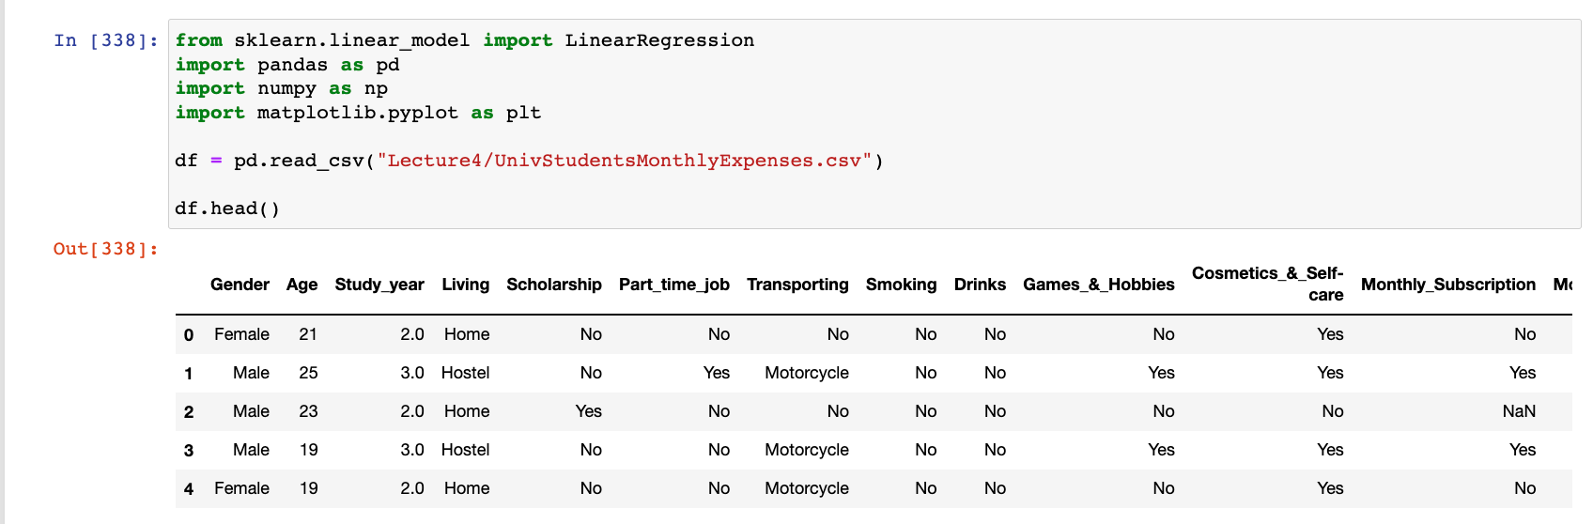
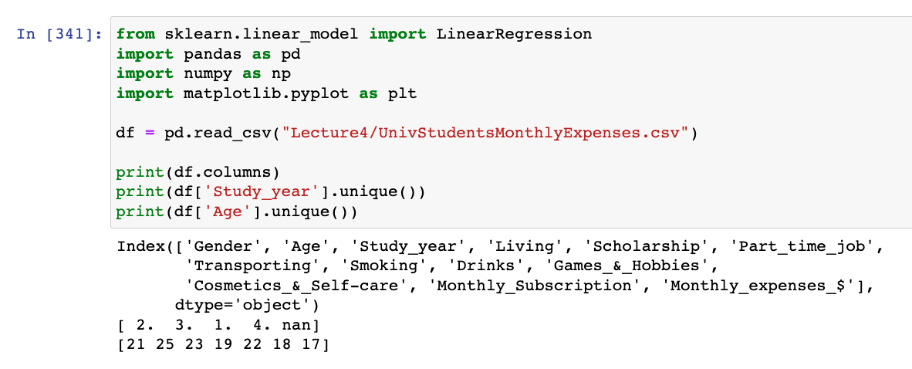
Linear Regression with Sklearn
Note the missing study year values in the dataset

Slide 22
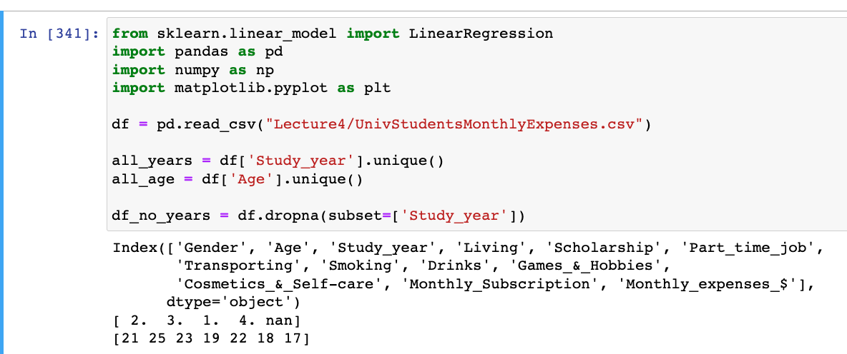
Linear Regression with Sklearn
We need to ‘fit’ our linear regression model.
To ‘fit’ a model means that you're making your algorithm learn the relationship between predictors and outcome so that you can predict the future values of the outcome
Therefore, we need to “train” or “fit” the linear regression model with the age and study year rows that have values.

Slide 23
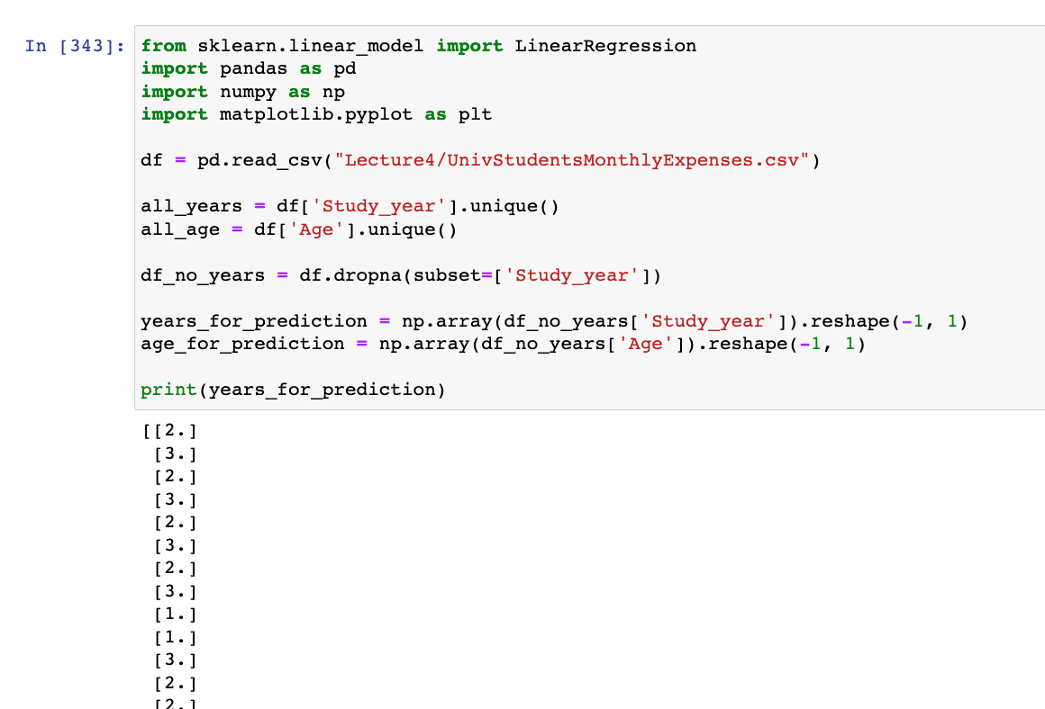
Linear Regression with Sklearn
Therefore, we need to “train” or “fit” the linear regression model with the age and study year rows that have values.
We’ll extract those columns into their own separate values.
Notes:
The columns need to be of type array (np.array)
Instead of being an 1D array ([1,2,3]), the values need to be in a 2D array [[1], [2], [3]]

Slide 24
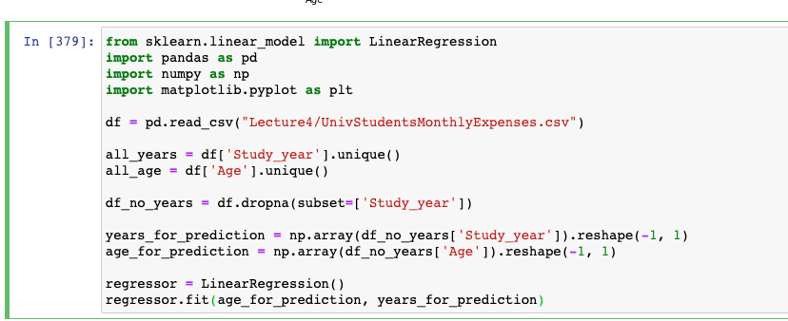
Linear Regression with Sklearn
Now we’ll use sklearn’s LinearRegression function to create the regression model.
We’ll use the known values for age, age_for_prediction, and years, years_for_prediction, as the x and y values, respectively, to fit (regressor.fit) the model.

Slide 25
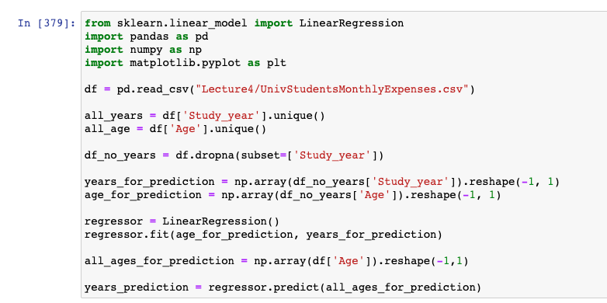
Linear Regression with Sklearn
Then we will use regressor.predict on all the ages (including rows for which the study year is missing) to try to predict the study year values, years_prediction.

Slide 26
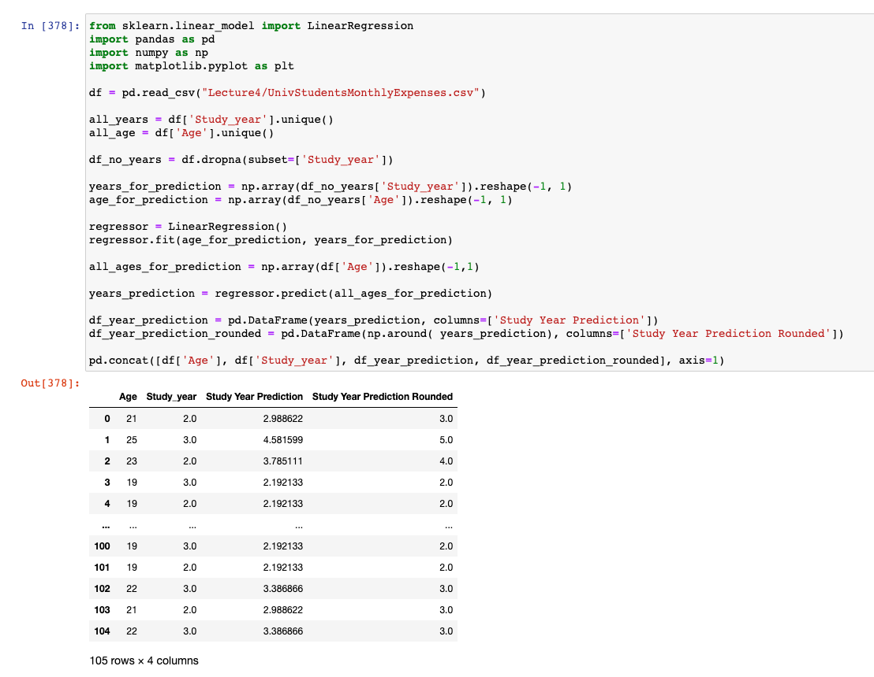
Linear Regression with Sklearn
See how the actual Study_year values compare to the predicted, Study Year Prediction, and rounded predictions Study Year Prediction Rounded.

Slide 27
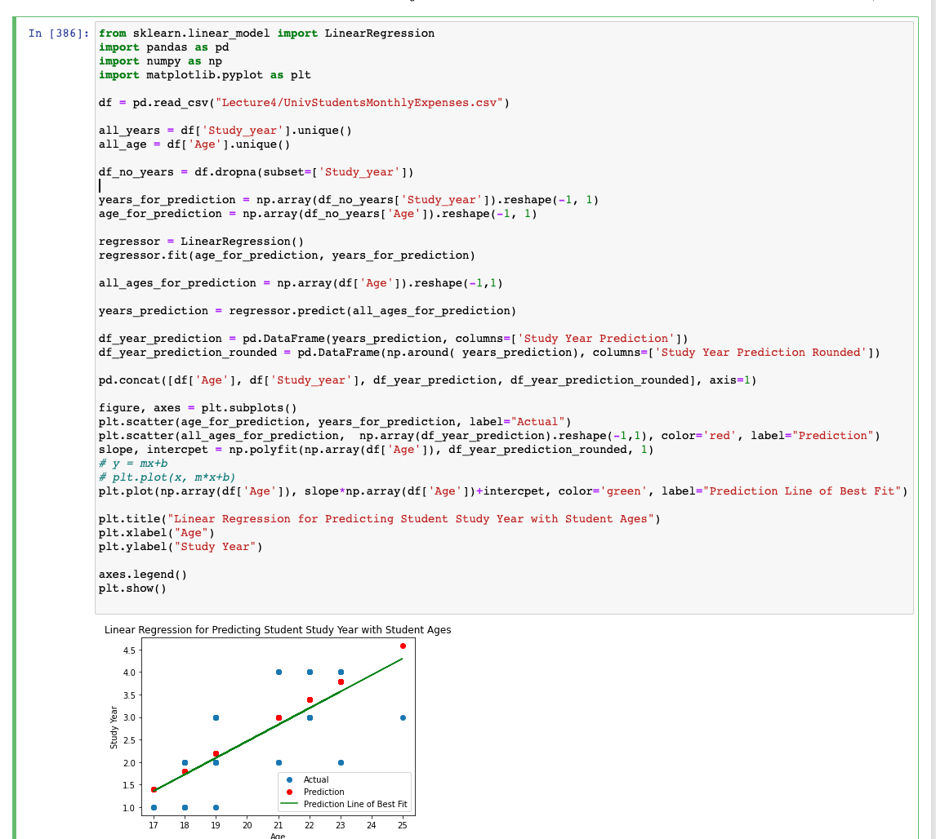
Linear Regression with Sklearn: Plotting the Result
We can also see how the linear regression prediction performs by plotting the
(Blue) Actual ages and years
(Red) Actual ages and predicted years
(Green) The line of best fit for linear regression model

Slide 28
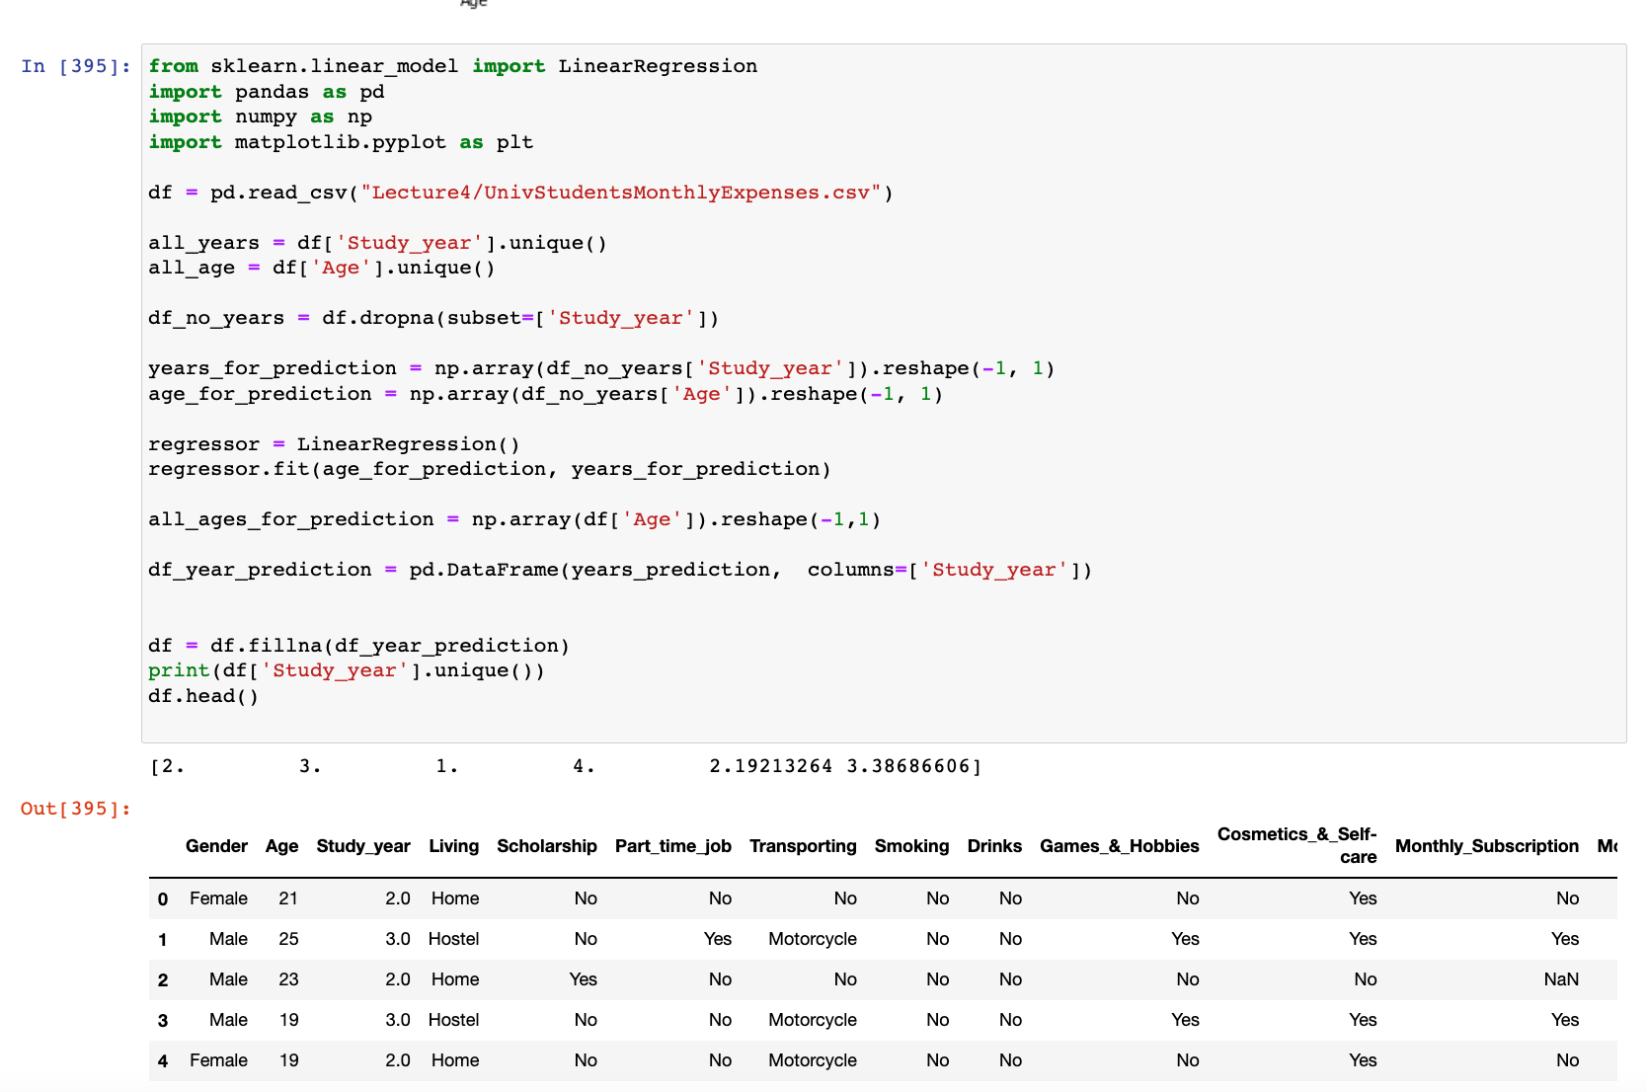
Linear Regression with Sklearn
Let’s finally replace our missing study year values in our datafame with our predicted values (rounded).

